Slide 1
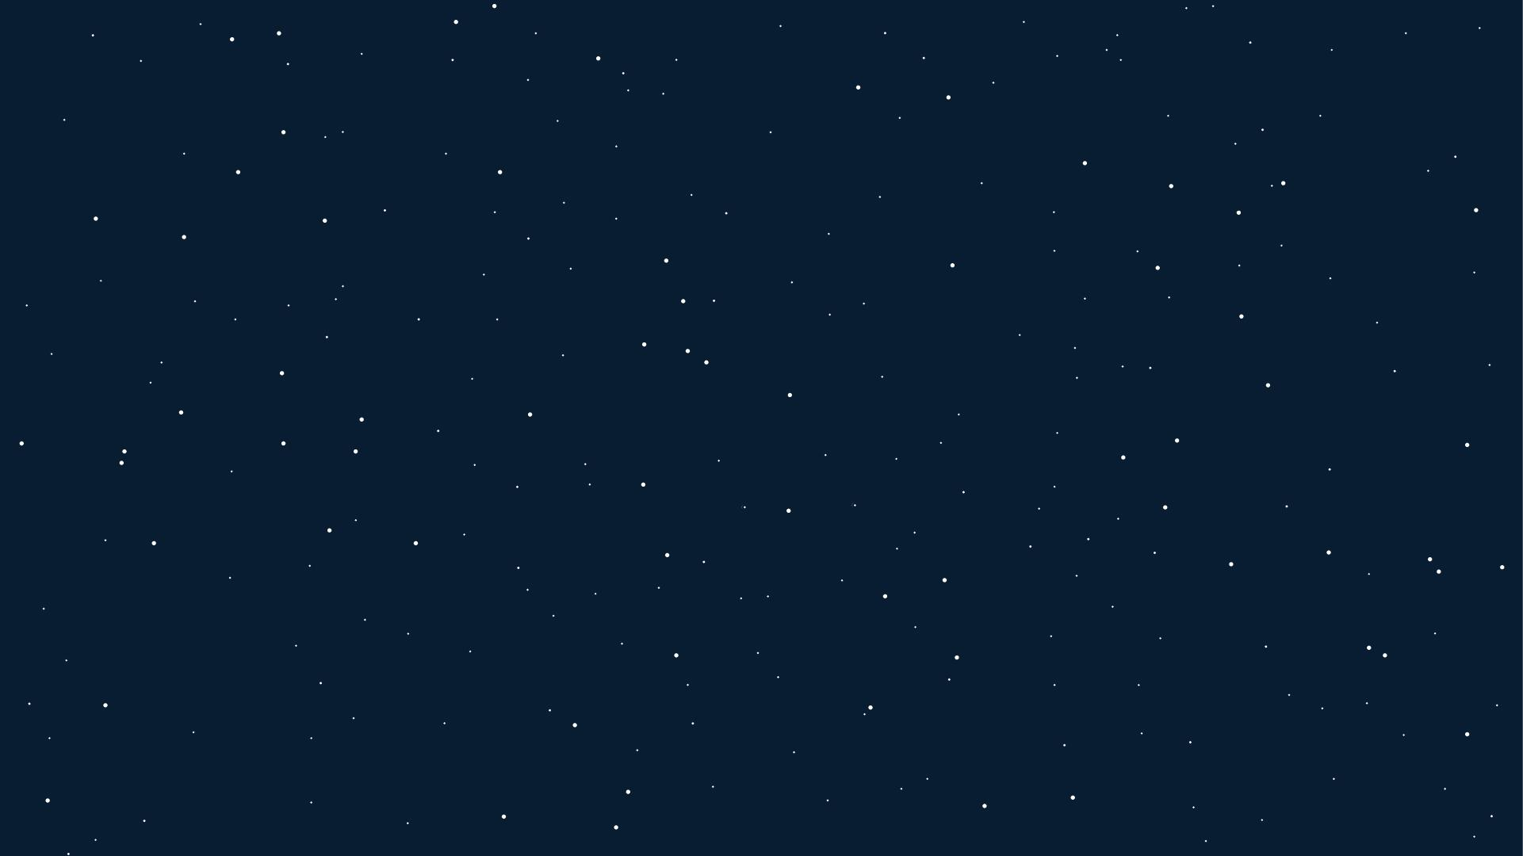
Introduction to AI
There are 3 imposters who pass

Slide 2
Assignment 1 report
Imposter: Vuong Ba Thinh
Crewmates: Nguyen Tran Quang Minh
Thai Van Nhat
Van Chan Duong

Slide 3
agenda
Problem definition
Cost Function and Heuristic
Improvements
Example Input/Output
Demonstration
Guides on using the implementation
References

Slide 4
Problem definition
Introduction
State space
Legal moves
Example Input/Output

Slide 5
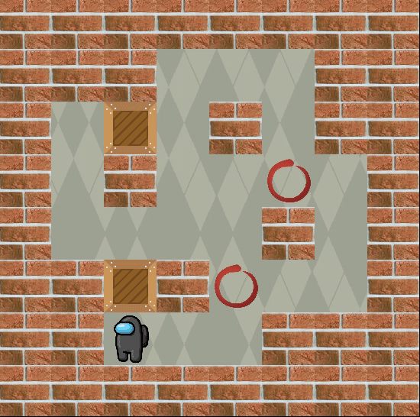
introduction
Sokoban (倉庫番, Sōko-ban) is a puzzle video game genre.​
The game is played on board of squares:
Squares are either on floor or a wall
Some floors which contain crates or marked as storage locations
Figure 1: A sokoban puzzle being solved
Notes:
Sokoban (倉庫番, Sōko-ban) is a puzzle video game genre in which the player pushes crates or boxes around in a warehouse, trying to get them to storage locations.

Slide 6
introduction
Player can move horizontally or vertically onto empty squares.
Crates:
can be pushed to the square beyond.
can’t be pushed into a wall or other boxes
Number of crates = number of storage locations.
The puzzle is solved when all crates are placed at storage locations.
Figure 1: A sokoban puzzle being solved
Notes:
The game is played on a board of squares, where each square is a floor or a wall. Some floor squares contain boxes, and some floor squares are marked as storage locations.
The player is confined to the board and may move horizontally or vertically onto empty squares (never through walls or boxes). The player can move a box by walking up to it and push it to the square beyond. Boxes cannot be pulled, and they cannot be pushed to squares with walls or other boxes. The number of boxes equals the number of storage locations. The puzzle is solved when all boxes are placed at storage locations.

Slide 7
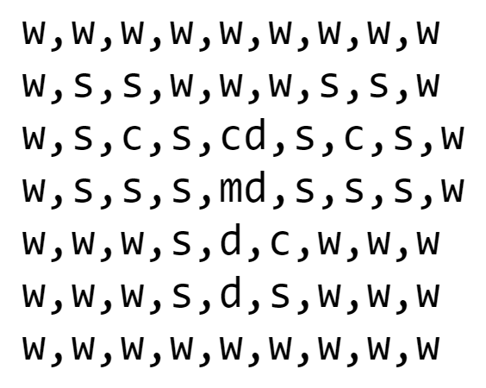
State spaces
Used character to indicate the current position of the objects
The initial map characterized as shown in the picture:
w: walls
s: spaces
c: crates
d: destinations
cd: crates on destinations
m: main character
md: main character on destinations
Figure 2: An example characterized map for Micro Cosmos 1 level

Slide 8
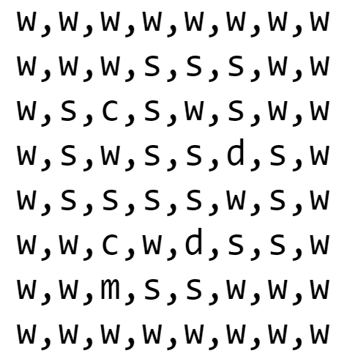
State spaces
The state then is defined as the position of the main player and the position of the crates at the current time.
Initial state:
The position of the objects in the current map + The initial position of the crates and the main player
Goal state:
The position of the destinations matched the position of the crates
Figure 3: An example characterized map for Mini Cosmos 2 level

Slide 9
State spaces
Initial state:
array﻿([6 2 2 2 5 2])
crates: [[[2 2]][[5 2]]]
dest: [[3 5][5 4]]
Goal state:
crates: [[[3 5]][[5 4]]]
dest: [[3 5][5 4]]
Figure 3: An example characterized map for Mini Cosmos 2 level

Slide 10
Legal moves
Based on the rules of the games mentioned on the introduction:
Main character:
Only move vertically or horizontally
Can’t go through walls or boxes
Can push the boxes beyond his direction
Crate:
can be pushed to the square beyond.
can’t be pushed into a wall or other boxes.

Slide 11
Legal moves
Current state:
array([6 2 2 2 5 2])
New states for this state can be:
array([5 2 2 2 4 2])
array([6 3 2 2 5 2])
Figure 3: An example characterized map for Mini Cosmos 2 level

Slide 12
Example input/output
Figure 4: An input for for Mini Cosmos 2 level
Figure 5: Output for the given map on Figure 4

Slide 13
COST FUNCTION AND HEURISTIC
Moves
Manhattan distance
Deadlock recognition

Slide 14
MOVES
The player can move in 4 directions (Up, Down, Left, Right)
If that direction is legal:
No wall
No push crate to wall
No push crate to crate
That direction will be executed
If the player move that direction without being deadlock → Store that direction and update the new position of crates and player to the game sate

Slide 15
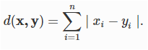
MANHATTAN DISTANCE
The manhattan distance between two points
x = (x1, x2, …, xn) and y = (y1, y2, …, yn) is

Slide 16
Heuristic
The heuristic we used consists of minimizing the cost function and deadlock pattern recognition
Although deadlock pattern recognition was a part of heuristic, we used it together with the blind search to create a feasible time and resource solution.
=> To easily generate output for comparing with A* algorithm
Notes:
Deadlock -> Where no solution can be generated

Slide 17
Cost function
We referenced Mr. KnightOfLuna implementation:
Used the least number of moves (without including the pushes) as the cost of the cheapest path from the initial state to node n. (Uniform-cost search g(n))
And the minimum manhattan distances from the current creates to the destinations as the greedy search cost h(n)

Slide 18
Cost function
Cost = <TOTAL MOVES WITHOUT PUSHING> +
<MANHATTAN DISTANCE from current crates to destination>
The cost function f can be defined as

Slide 19
Improvements
We decided to identify the least number of pushes as stated in this paper as the uniform-cost search: “Optimal Sokoban solving using pattern databases with specific domain knowledge”
“...The most common objective is to find a solution which minimizes the number of pushes, without accounting the moves of the man...”

Slide 20
Improvements
Cost = <total push from start> +
<MANHATTAN DISTANCE from current crates to destination>
Therefore the cost function f we used can be defined as

Slide 21
Improvements
Also we utilized the numpy array for storing the states (as original implementation used tuples and lists)
=> The performance was improved (on searching time criteria)

Slide 22
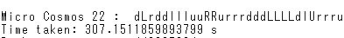
Improvements
Timeout limit was set to 1500 seconds
On using tuples and lists as original implementation => The Micro cosmos level 22 on a* method: timed out
On using numpy array => no timeout and time taken was better

Slide 23
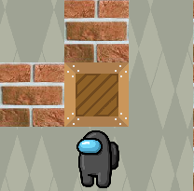
DEADLOCK
These patterns are used to recognize potentials deadlock
=> Helps pruning the search, reducing time and space
Figure 6: Crate stucks in the corner of 2 walls
Notes:
Deadlock -> Where no solution can be generated

Slide 24
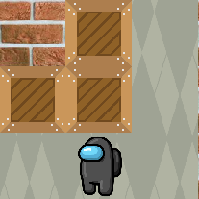
DEADLOCK
These patterns are used to recognize potentials deadlock
=> Helps pruning the search, reducing time and space
Figure 7: Crate stuck in a corner of 2 crates and 1 wall
Notes:
Deadlock -> Where no solution can be generated

Slide 25
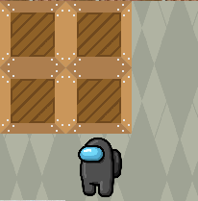
DEADLOCK
These patterns are used to recognize potentials deadlock
=> Helps pruning the search, reducing time and space
Figure 8: Crate stucks in a corner of 3 crates
Notes:
Deadlock -> Where no solution can be generated

Slide 26
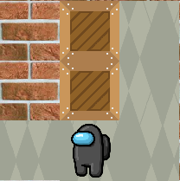
DEADLOCK
These patterns are used to recognize potentials deadlock
=> Helps pruning the search, reducing time and space
Figure 9: Crate stucks in a corner of 2 creates and 2 walls - first pattern
Notes:
Deadlock -> Where no solution can be generated

Slide 27
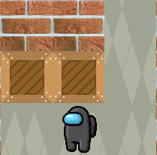
DEADLOCK
These patterns are used to recognize potentials deadlock
=> Helps pruning the search, reducing time and space
Figure 10: Crate stucks in a corner of 2 creates and 2 walls - second pattern
Notes:
Deadlock -> Where no solution can be generated

Slide 28
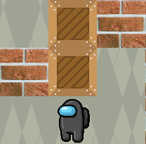
DEADLOCK
These patterns are used to recognize potentials deadlock
=> Helps pruning the search, reducing time and space
Figure 11: A weird variation of 1 crates and 2 walls pattern- first pattern
Notes:
Deadlock -> Where no solution can be generated

Slide 29
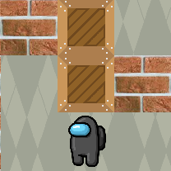
DEADLOCK
These patterns are used to recognize potentials deadlock
=> Helps pruning the search, reducing time and space
Figure 11: A weird variation of 1 crates and 2 walls pattern - second pattern
Notes:
Deadlock -> Where no solution can be generated

Slide 30

DEMON
STRATION

Slide 31
Guide on using the implementation
Required extra packages for running the game:
pygame
tqdm
All of these packages can be installed using pip:
pip install -r requirements.txt

Slide 32
Guide on using the implementation
On the project dir run:
python game.py
Or just run:
game.exe
Note: When searching the UI will appear as Not responding, this is not the game crashing, it’s just the game taking time to do it handful searching job
Note: Sometime it’ll crash while auto running the result. Don’t worry, just start it again T T

Slide 33
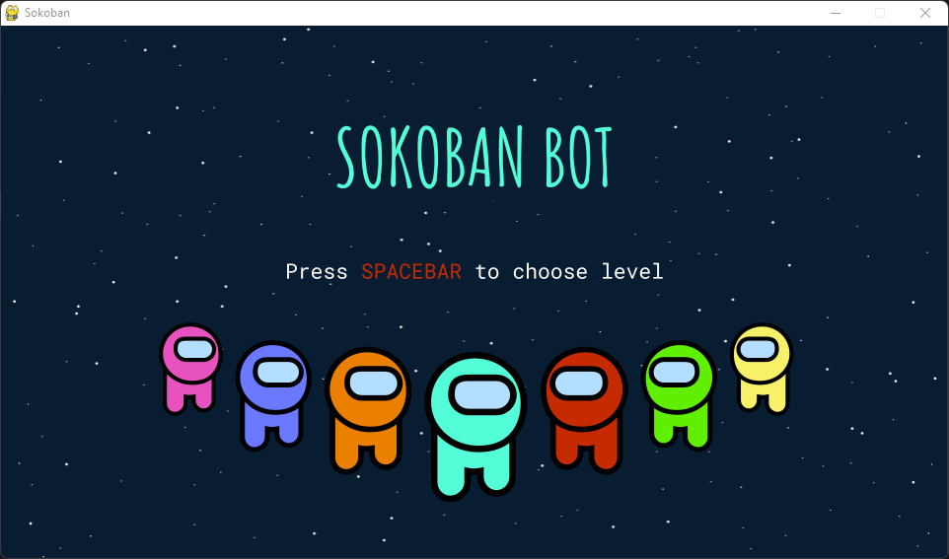
Game tutorial
Title screen after start-up looks like this.
Just press SPACEBAR or click on screen to proceed.

Slide 34
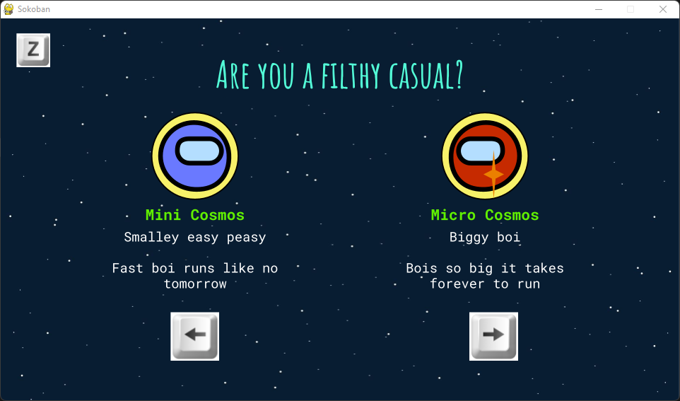
Game tutorial
After that, it’s the level set choosing, between Mini Cosmos and Micro Cosmos
Press either Arrow keys or click on 1 screen side to proceed.
Or press/click on z to return to Title.

Slide 35
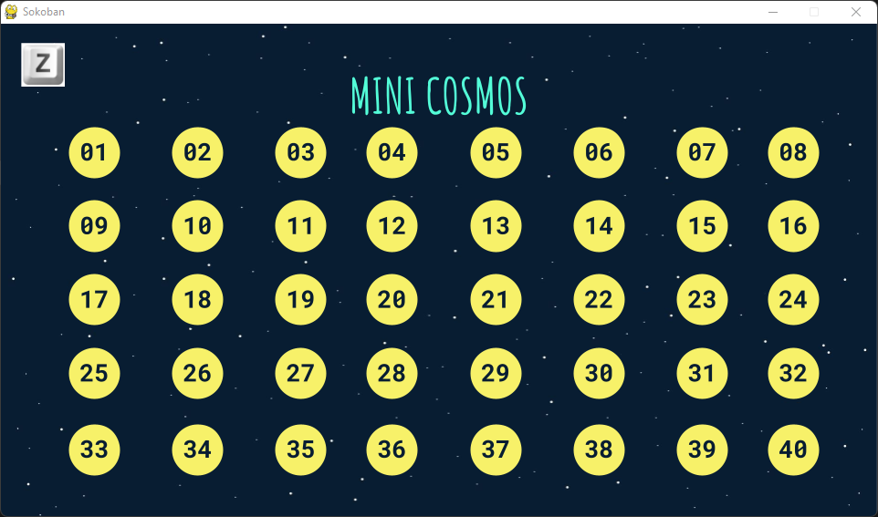
Game tutorial
Choose the level 1 - 40
Click on one of the number or type them
Ex: type 1 and 2 in order will choose 12.
Press/click on z to return to set choosing

Slide 36
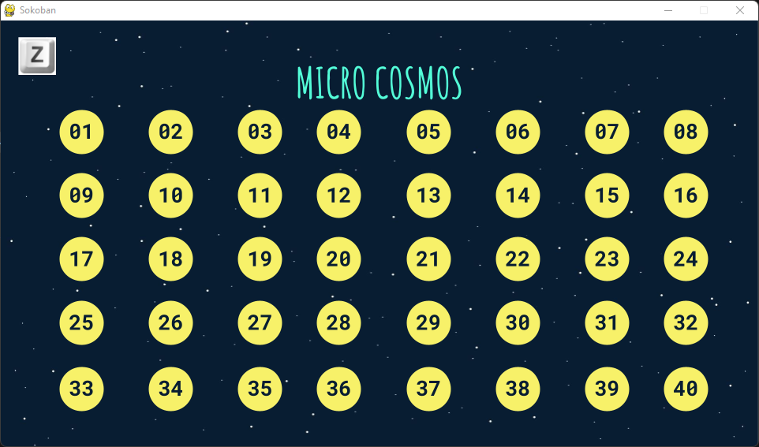
Game tutorial
Choose the level 1 - 40
Click on one of the number or type them
Ex: type 1 and 2 in order will choose 12.
Press/click on z to return to set choosing

Slide 37
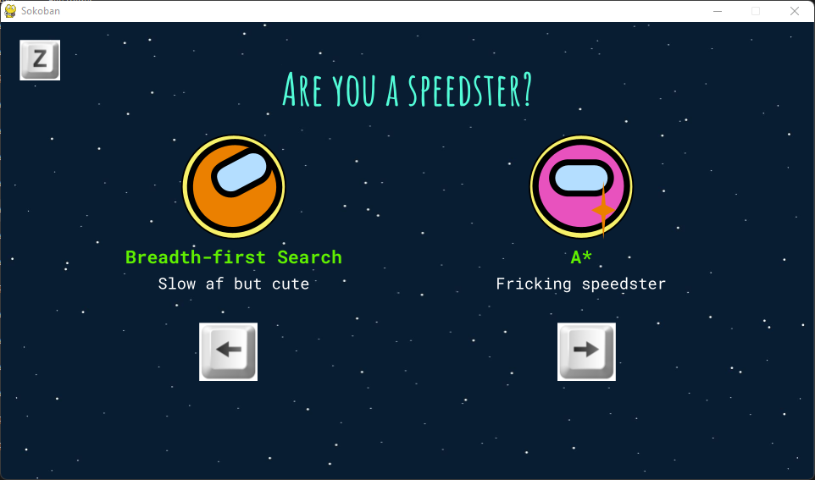
Game tutorial
After that, it’s the search method choosing, between Breadth-first Search and A*
Press either Arrow keys or click on 1 screen side to proceed.
Or press/click on z to return to Title.

Slide 38
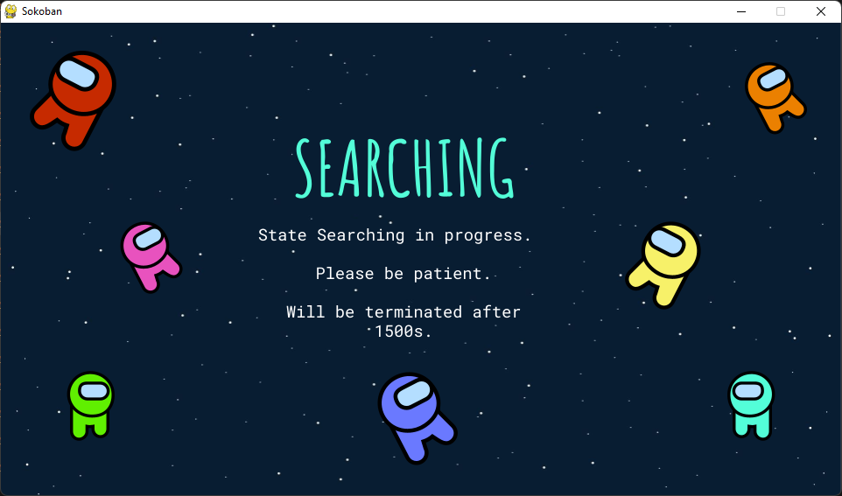
Game tutorial
Searching in progress
Max runtime on our local machine is appx 1400s for one of the Micro Cosmos BFS algorithm
Please be patient since the screen might look Not Responding

Slide 39
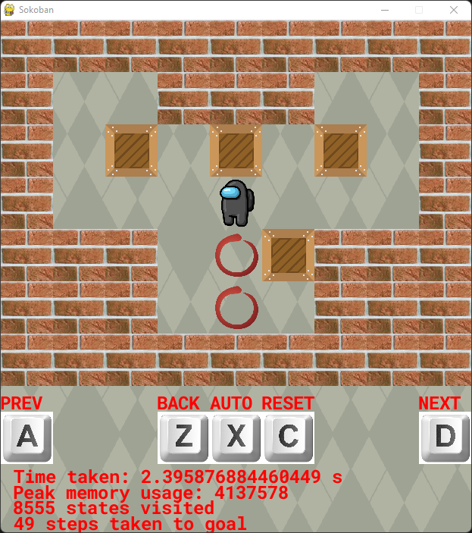
GAME TUTORIAL
Wall
Crate
Main character
Destination
Previous screen
Reset to initial state
Previous move
Next move
Auto/Manual mode

Slide 40
references
sokoban-solver. (KnightOfLuna). Retrieved October 12, 2021, from https://github.com/KnightofLuna/sokoban-solver
Pereira, A. G., Ritt, M., &amp; Buriol, L. S. (2015, June 11). Optimal Sokoban solving using pattern databases with specific domain knowledge. Artificial Intelligence. Retrieved October 12, 2021, from https://www.sciencedirect.com/science/article/pii/S0004370215000867
Theme inspired from Among Us game, with template taken from
https://slidesgo.com/theme/impostors-among-crewmates

